Slide 1
Cyber Security and Forensics AICT006-4-2-DSF VE-3
Cryptography

Slide 2
Topic & Structure of The Lesson
Cryptographic Techniques
Symmetric
Asymmetric
Hash function

Slide 3
Learning Outcomes
At the end of this topic, you should be able to
Differentiate three main cryptographic techniques

Slide 4
Key Terms You Must Be Able To Use
If you have mastered this topic, you should be able to use the following terms correctly in your assignments and exams:
Cryptographic Techniques
Symmetric
Asymmetric
Hash function

Slide 5
Secure Systems
1. Security policy
What needs to be protected
Kinds/level of protection
Responsibilities
Auditing policy
2. Security environment
Physical environment
Physical security
Hardware, operating system
Firewalls, etc.
3. Security mechanisms
Cryptography
Authentication
Security protocols
Monitoring and auditing procedures
Monitor access
Audit trails
Feedback on failures, security breaches
Containment & recovery

Slide 6
Cryptography Concepts

Slide 7
Cryptography
Latin
Cryptography
Crypt
secret
Graphia
writing
And when you need a shoulder to cry on
When you need a friend to rely on
When the whole world is gone
You won't be alone, cause I'll be there
I'll be your shoulder to cry on
Wqewqewqdadsad sdfvfkjvjev
vczcvpvfdjvfdv vcxvcxvxcvcx
Zzzzzzzzp oidcdv sddsfsdvsdv
Qwerrdad poiunf
Jsdska ooopqiq $32156daja
Notes:
To study of how to obscure what you write so as to render is selectively unintelligible. Nowadays, cryptography more involve much more elements than secret writing. In this course we will focus on modern cryptography. Modern cryptography is remarkable discipline, it is a a cornerstone of computer and communication security, with end products that are imminently practical.

Slide 8
Cryptography
Concerned with developing algorithms:
Verify the correctness of a message to the recipient.
Form the basis of many technological solutions to computer
and communications security problems
cryptography - study of encryption principles/methods
Notes:
To study of how to obscure what you write so as to render is selectively unintelligible. Nowadays, cryptography more involve much more elements than secret writing. In this course we will focus on modern cryptography. Modern cryptography is remarkable discipline, it is a a cornerstone of computer (batu asas) and communication security, with end products that are imminently practical (betul-betul berlaku dalam real life).

Slide 9
Goals & Setting
To ensure the security of communication across
an insecure channel.
The ideal channel:
Adversary (Attacker)
The source of all
possible threats
Dedicated, untappable, impenetrable
Pipe/tube
Sender
Receiver
Notes:
Modern cryptography addresses a wide of problems.
The most basic problem remains the classical one of ensuring security of communication across an insecure medium.
Two parties (sender & receiver) are provided with a dedicated, untappable, impenetrable pipe or tube which a sender can whisper a message and the receiver will hear it.
Nobody else can look inside the pipe or change what is there.
The pipe provides the perfect medium: available only to the sender and receiver, as though they were alone in the world.
Unfortunately, in real life, there are no ideal channels connecting the pairs of parties that might like to communicate each other . Usually such parties are communicating over some public network like the Internet.
The most basic goal of cryptography is to provide such parties with a means to imbue their communications with security properties akin (sejenis) to those provided by the ideal channel.

Slide 10
Basic Terminology
Plaintext - the original message
Ciphertext - the coded message
Cipher - algorithm for transforming plaintext to ciphertext
Key - info used in cipher known only to sender/receiver
Encipher (encrypt) - converting plaintext to ciphertext
Decipher (decrypt) - recovering ciphertext to plaintext
Cryptography – a study of encryption principles/methods
Cryptanalysis (codebreaking) - the study of principles/ methods of deciphering ciphertext without knowing key
Cryptology - the field of both cryptography and cryptanalysis
Steganography – the technique of hiding data within an ordinary, non-secret data or file
Notes:
Briefly review some terminology used throughout the course.

Slide 11


Simple Process
Sender
Receiver
Plaintext - The original Message
Plaintext - The original Message
The secret message is:
You can get A-/A+ in This subject; (however, depending on you)
The secret message is:
You can get A-/A+ in This subject; (however, depending on you)
Encryption
Decryption
Decipher (Decrypt)
recovering ciphertext to plaintext
Encipher (Encrypt) converting plaintext to ciphertext
Key
info used in cipher known only to sender/receiver
hjfjghkf@#@#$%^&jklll
098GHJFD!@#$#$#$%
Cipher
Algorithm for transforming plaintext to ciphertext
Ciphertext
The coded message
Notes:
The message that send / transmit is referred to as a plain text.
The sender encrypts the plain text under the share key to obtain a ciphertext.
The ciphertext is transmitted to the receiver.
A cipher is used to accomplish the encryption and decryption or: a method of transforming a text in order to conceal its meaning.
The ciphertext is transported securely from prying eyes to the intended recipient(s), where it is decrypted back into plaintext.

Slide 12
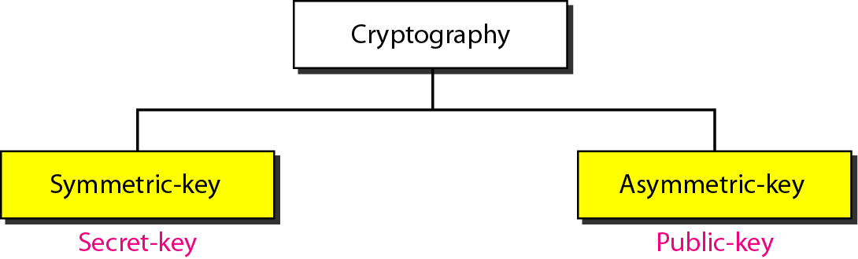
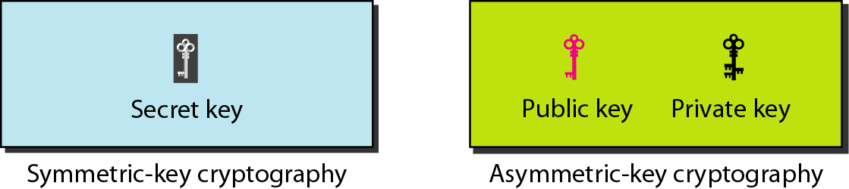
Categories of cryptography
conventional / private-key / single-key
sender and recipient share a common key
all classical encryption algorithms are private-key
uses two keys – a public & a private key
asymmetric since parties are not equal
uses clever application of number theoretic concepts to function
complements rather than replaces private key crypto

Slide 13
Information Protection by Cryptography

Slide 14
Cryptography and Security
Characteristic | Description | Protection
Confidentiality | Ensures that only authorized parties can view the information. | Encrypted information can only be viewed by those who have been provided the key.
Integrity | Ensures that the information is correct and no unauthorized person or malicious software has altered that data. | Encrypted information cannot be changed except by authorized users who have the key.
Availability | Ensures that data is accessible to authorized users. | Authorized users are provided the decryption key to access the information.
Authenticity | Provides proof of the genuineness of the users. | Cryptography can prove that the sender was legitimate and not an imposter.
Non-repudiation | Proves that a user performed an action. | Cryptography non-repudiation prevents an individual from fraudulently denying they were involved in a transaction.
Notes:
All traditional schemes are symmetric / single key / private-key encryption algorithms, with a single key, used for both encryption and decryption, since both sender and receiver are equivalent, either can encrypt or decrypt messages using that common key.

Slide 15
Symmetric Encryption

Slide 16
Symmetric Encryption
conventional / secret-key / single-key
sender and recipient share a common key
all encryption algorithms are private-key
2 Techniques: Classical & Modern
Classical Techniques
Modern Techniques
Substitution:
Caesar Cipher
Monalphabatic Cipher
Playfair Cipher
Hill Cipher
Polyalphabetic Cipher
One-Time Pad
Transposition
Rotor Machines
DES
3DES
AES
Blowfish
Serpent
Twofish
Notes:
All traditional schemes are symmetric / single key / private-key encryption algorithms, with a single key, used for both encryption and decryption, since both sender and receiver are equivalent, either can encrypt or decrypt messages using that common key.

Slide 17

Symmetric Cipher Model
A secret key shared by
Sender and recipient
A secret key shared by
Sender and recipient
Sender
Receiver
The secret message is:
You can get A-/A+ in This subject; (however, depending on you)
The secret message is:
You can get A-/A+ in This subject; (however, depending on you)
Encryption
Transmitted
Ciphertext
Decryption
Encryption Algorithm
(e.g., DES)
Decryption Algorithm
(Reverse of encryption
algorithm)
Plaintext
Input
Plaintext
Output
Notes:
The message that send / transmit is referred to as a plain text.
The sender encrypts the plain text under the share key to obtain a ciphertext.
The ciphertext is transmitted to the receiver.
A cipher is used to accomplish the encryption and decryption or: a method of transforming a text in order to conceal its meaning.
The ciphertext is transported securely from prying eyes to the intended recipient(s), where it is decrypted back into plaintext.

Slide 18
Requirements
two requirements for secure use of symmetric encryption:
a strong encryption algorithm
a secret key known only to sender/receiver, have:
plaintext X
ciphertext Y
key K
encryption algorithm Ek
decryption algorithm Dk
Ciphertext Y = EK(X) Plaintext X = DK(Y)
assume encryption algorithm is known
implies a secure channel to distribute key
Notes:
Generally assume that the algorithm is known.
This allows easy distribution of s/w and h/w implementations.
Hence assume just keeping key secret is sufficient to secure encrypted messages.
Have plaintext X, ciphertext Y, key K, encryption algorithm Ek, decryption algorithm Dk.

Slide 19


What are the essential ingredients of a symmetric cipher?
ⓘ Start presenting to display the poll results on this slide.

Slide 20
How many keys are required for two people to communicate via a cipher?
ⓘ Start presenting to display the poll results on this slide.

Slide 21
Questions
What are the essential ingredients of a symmetric cipher?
Plaintext, encryption algorithm, secret key, ciphertext, decryption algorithm.
How many keys are required for two people to communicate via a cipher?
One secret key.

Slide 22
Explanation of Symmetric Encryption Techniques
Symmetric Encryption
Classical Technique
Modern Technique
Stream cipher
Block cipher
Substitution
Transposition
Rotor Machines
Steganography
DES
3DES
AES
Blowfish
Serpent
Twofish

Slide 23
Stream Cipher

Slide 24
Stream Cipher Structure
A typical stream cipher encrypts plaintext one byte at a time.
Use a key as input to a pseudorandom bit generator that produces a stream of 8-bit numbers that are apparently random.
Pseudorandom stream is one that is unpredictable without knowledge of the input key.
Key K
Key K
Pseudorandom byte
Generator
(key stream generator)
Pseudorandom byte
Generator
(key stream generator)
K
K
Plaintext
Byte stream
M
+
Ciphertext
Byte stream
C
+
Plaintext
Byte stream
M
Encryption
Decryption

Slide 25
Stream Cipher Structure
The output of the generator, called a keystream, is combined one byte at a time with the plaintext stream using the bitwise exclusive-OR (XOR) operation.
11001100 Plaintext
+
01101100 key stream
10100000 Ciphertext
Decryption requires the use of the same pseudorandom sequence:
10100000 Ciphertext
+
01101100 key stream
11001100 Plaintext

Slide 26
Examples of Classical Technique
Substitutions are effective cryptographic devices. In fact, they were the basis of many cryptographic algorithms used for diplomatic communication through the first half of the century.
But substitution is not the only kind of encryption technique. The goal of substitution is confusion; the encryption method is an attempt to make it difficult for a cryptanalyst or intruder to determine how a message and key were transformed into ciphertext.
Substitution
1
Transposition
A transposition is an encryption in which the letters of the message are rearranged. With transposition, cryptography aims for diffusion, widely spreading the information from the message or key across the ciphertext. Transpositions try to break established patterns. Because a transposition is rearranged of the symbols of a message, it is also known as a permutation.
2
Notes:
In this section and the next, we examine a sampling of what might be called classical encryption
techniques. A study of these techniques enables us to illustrate the basic approaches to
symmetric encryption used today and the types of cryptanalytic attacks that must be anticipated.
The two basic building blocks of all encryption techniques: substitution and transposition.
We examine these in the next two sections. Finally, we discuss a system that combine both
substitution and transposition.

Slide 27
1. Substitution (Caesar Cipher)
where letters of plaintext are replaced by other letters or by numbers or symbols.
or if plaintext is viewed as a sequence of bits, then substitution involves replacing plaintext bit patterns with ciphertext bit patterns.
earliest known substitution cipher by Julius Caesar
first attested use in military affairs
Notes:
Substitution ciphers form the first of the fundamental building blocks. The core idea is to replace one basic unit (letter/byte) with another. Whilst the early Greeks described several substitution ciphers, the first attested use in military affairs of one was by Julius Caesar, described by him in Gallic Wars (cf. Kahn pp83-84). Still call any cipher using a simple letter shift a caesar cipher, not just those with shift 3.
Note: when letters are involved, the following conventions are used in this course: Plaintext is always in lowercase; ciphertext is in uppercase; key values are in italicized lowercase.

Slide 28
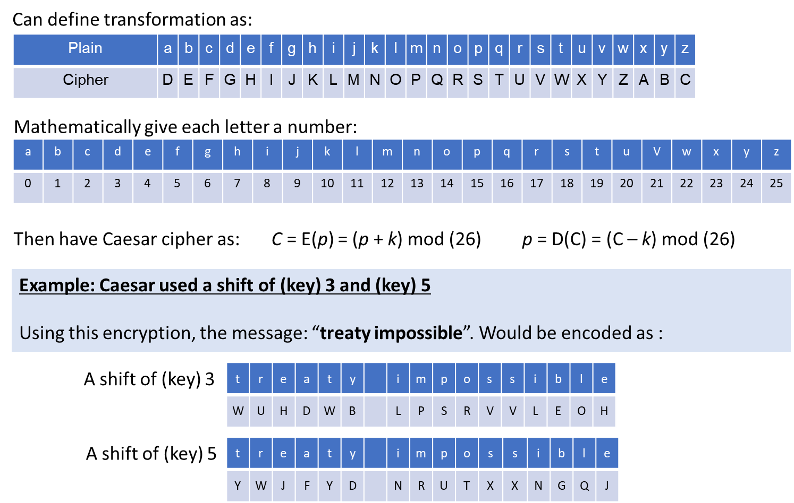
Caesar Cipher
Notes:
This mathematical description uses modulo arithmetic (ie clock arithmetic). Here, when you reach Z you go back to A and start again. Mod 26 implies that when you reach 26, you use 0 instead (ie the letter after Z, or 25 + 1 goes to A or 0).
Example: howdy (7,14,22,3,24) encrypted using key f (5) is MTBID

Slide 29
To test your understanding
Caesar wants to arrange a secret meeting with Marc Anthony, either at the Tiber (the river) or at the Coliseum (the arena). He sends the ciphertext EVIRE. However, Anthony does not know the key, so he tries all possibilities. Where will he meet Caesar?
Among the shifts of EVIRE, there are two words: arena and river. Therefore, Anthony cannot determine where to meet Caesar.

Slide 30
Cryptanalysis of Caesar Cipher
only have 26 possible ciphers
A maps to A, B,..Z
could simply try each in turn
a brute force search
given ciphertext, just try all shifts of letters
do need to recognize when to have plaintext
Notes:
With a caesar cipher, there are only 26 possible keys, of which only 25 are of any use, since mapping A to A etc doesn't really obscure the message! cf. basic rule of cryptanalysis "check to ensure the cipher operator hasn't goofed and sent a plaintext message by mistake"!
Can try each of the keys (shifts) in turn, until can recognise the original message. See Stallings Fig 2.3 for example of search.
Note: as mentioned before, do need to be able to recognise when have an original message (ie is it English or whatever). Usually easy for humans, hard for computers. Though if using say compressed data could be much harder.
Example "GCUA VQ DTGCM" when broken gives "easy to break", with a shift of 2 (key C).

Slide 31
2. Transposition Ciphers
now consider classical transposition or permutation ciphers
these hide the message by rearranging the letter order
without altering the actual letters used
can recognise these since have the same frequency distribution as the original text
Notes:
Transposition Ciphers form the second basic building block of ciphers. The core idea is to rearrange the order of basic units (letters/bytes/bits) without altering their actual values.

Slide 32
Rail Fence cipher
write message letters out diagonally over a few rows
then read off cipher row by row
e.g., write the message out as: “meet me after the toga party”
m
e
m
a
t
r
h
t
g
p
r
y
e
t
e
f
e
t
e
o
a
a
t
giving ciphertext: MEMATRHTGPRYETEFETEOAAT
1st Row
m
e
m
a
t
r
h
t
g
p
r
y
2nd Row
e
t
e
f
e
t
e
o
a
a
t
Notes:
Example message is: "meet me after the toga party" with a rail fence of depth 2.

Slide 33
Row Transposition Ciphers
a more complex scheme is to write the message in a rectangle, row by row, and read the message off, column by column, but permute the order of the columns. The order of the columns then becomes the key of the algorithm.
write letters of message out in rows over a specified number of columns.
then reorder the columns according to some key before reading off the rows.
attack postponed until two am xyz
Key | 4 | 3 | 1 | 2 | 5 | 6 | 7
Plaintext | a | t | t | a | c | k | p
 | o | s | t | p | o | n | e
 | d | u | n | t | i | l | t
 | w | o | a | m | x | y | z
Ciphertext | T | T | N | A | A | P | T | M | T | S | U | O | A | O | D | W | C | O | I | X | K | N | L | Y | P | E | T | Z

Slide 34
Row Transposition Ciphers
Let’s try!
KEY – LOVES
Plaintext – TOO SLEEPY
CIPHERTEXT - SYTEOELOP
Key | L | O | V | E | S
Number arrangement | 2 | 3 | 5 | 1 | 4
Plaintext | T | O | O | S | L
 | E | E | P | Y

Slide 35
Product Ciphers
Ciphers using substitutions or transpositions are not secure because of language characteristics
Hence consider using several ciphers in succession to make it harder, but:
two substitutions make a more complex substitution
two transpositions make more complex transposition
but a substitution followed by a transposition makes a new much harder cipher
this is bridge from classical to modern ciphers

Slide 36
Block Ciphers

Slide 37
Block Ciphers
A block cipher is one in which a block of plaintext is treated as a whole and used to produce a ciphertext block of equal length.
Typically, a block size of 64 or 128 bits is used.
Block cipher algorithms can operate in many Modes. A block cipher algorithm can be a :
Electronic Codebook Mode
Cipher block Chaining Mode
Cipher Feedback Mode
Output Feedback Mode
Counter Mode
provide secrecy and/or authentication services

Slide 38
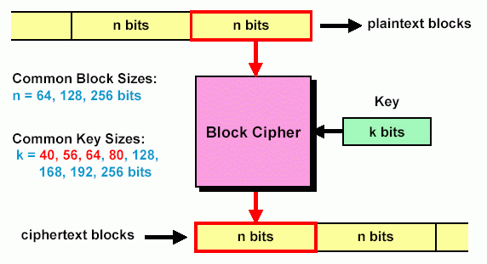
Block Cipher Design
Divide input bit stream into n-bit sections, encrypt only that section, no dependency/history between sections
In a good block cipher, each output bit is a function of all n input bits and all k key bits

Slide 39
Public-key Cryptography

Slide 40
Private-Key Cryptography Definition
Public-key/two-key/asymmetric cryptography involves the use of two keys:
a public-key, which may be known by anybody, and can be used to encrypt messages, and verify signatures
a private-key, known only to the recipient, used to decrypt messages, and sign (create) signatures
Asymmetric because
those who encrypt messages or verify signatures cannot decrypt messages or create signatures

Slide 41
Private-Key Cryptography - Concept
Allows users to communicate securely without having prior access to a shared secret key,
by using a pair of cryptographic keys, designated
as public key and
private key, which are related mathematically.
The private key is generally kept secret, while the public key may be widely distributed.
In a sense, one key "locks" a lock; while the other is required to unlock it. It should not be possible to deduce the private key of a pair given the public key.

Slide 42
Public-Key Basic Concept
Alice
Message (M)
Plaintext
Message (M)
Plaintext
Ciphertext
Bob
Man needs
Woman,
Woman
Needs
Money for
shopping
123456696
096785403
657849302
610395867
567484509
121212347
Man needs
Woman,
Woman
Needs
Money for
shopping
Message is encrypted
Message is decrypted
E_{B}
D_{B}
Bob’s Public Key (E_{B})
Bob’s Private Key (D_{B})

Slide 43
Public-Key Basic Concept
Alice
Message (M)
Plaintext
Message (M)
Plaintext
Bob
Ciphertext
Man needs
Woman,
Woman
Needs
Money for
shopping
123456696
096785403
657849302
610395867
567484509
121212347
Man needs
Woman,
Woman
Needs
Money for
shopping
Message is encrypted
Message is decrypted
E_{B}
D_{B}
Confidentiality
This model provides no authentication because any party
could also use Bob’s “public key” to encrypt Message (M)

Slide 44
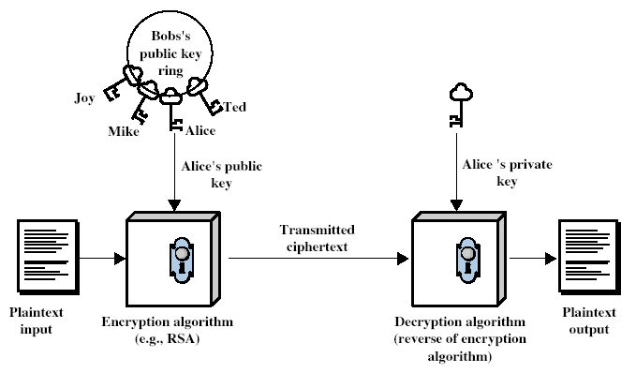
Private-Key Cryptography
Notes:
Stallings Fig 9-1.

Slide 45
Public-Key Cryptography Options
There are many forms of public-key cryptography, including:
Public-key encryption — keeping a message secret from anyone that does not possess a specific private key.
Public-key digital signature — allowing anyone to verify that a message was created with a specific private key.
key agreement — generally, allowing two parties that may not initially share a secret key to agree on one.
The most obvious application of a public key encryption system is confidentiality; a message that a sender encrypts using the recipient's public key can only be decrypted by the recipient's paired private key.
Public-key digital signature algorithms can be used for sender authentication. For instance, a user can encrypt a message with his own private key and send it. If another user can successfully decrypt it using the corresponding public key, this provides assurance that the first user (and no other) sent it.

Slide 46
To Provide Authentication & Signature
Alice
Message (M)
Plaintext
Message (M)
Plaintext
Ciphertext
Bob
Man needs
Woman,
Woman
Needs
Money for
shopping
123456696
096785403
657849302
610395867
567484509
121212347
Man needs
Woman,
Woman
Needs
Money for
shopping
E
D
Message is encrypted
Message is decrypted
E_{A}
D_{A}
Alice use her private key
Bob user Alice’s public key
Alice has “signed” the message
This model does provide authentication and digital signature
But, this scheme not provide confidentiality, because anyone
has Alice’s public key can decrypt the ciphertext.

Slide 47
To Provide Confidentiality, Authentication and Signature
Alice
Message (M)
Plaintext
Message (M)
Plaintext
Ciphertext
Bob
Man needs
Woman,
Woman
Needs
Money for
shopping
123456696
096785403
657849302
610395867
567484509
121212347
123456696
096785403
657849302
610395867
567484509
121212347
123456696
096785403
657849302
610395867
567484509
121212347
Man needs
Woman,
Woman
Needs
Money for
shopping
E
E
D
D
Message is encrypted
Message is encrypted
Message is decrypted
Message is decrypted
E_{A}
E_{B}
D_{B}
D_{A}
Alice use
her private key
Alice use
Bob’s public key
Bob use
his private key
Bob use
Alice’s public key
Digital Signature
&
Authentication
Confidentiality
Bottleneck: The public-key algorithm is complex and must be exercised four times rather than two in each communication

Slide 48
To Provide Confidentiality, Authentication and Signature
Alice
Message (M)
Plaintext
Message (M)
Plaintext
Ciphertext
Bob
Man needs
Woman,
Woman
Needs
Money for
shopping
123456696
096785403
657849302
610395867
567484509
121212347
123456696
096785403
657849302
610395867
567484509
121212347
123456696
096785403
657849302
610395867
567484509
121212347
Man needs
Woman,
Woman
Needs
Money for
shopping
E
E
D
D
Message is encrypted
Message is encrypted
Message is decrypted
Message is decrypted
Digital Signature
&
Authentication
Confidentiality

Slide 50
Why Public-Key Cryptography?
developed to address two key issues:
key distribution – how to have secure communications in general without having to trust a shared secret key
digital signatures – how to verify a message comes intact from the claimed sender
Notes:
The idea of public key schemes, and the first practical scheme, which was for key distribution only, was published in 1977 by Diffie & Hellman. The concept had been previously described in a classified report in 1970 by James Ellis (UK CESG) - and subsequently declassified in 1987. See History of Non-secret Encryption (at CESG). Its interesting to note that they discovered RSA first, then Diffie-Hellman, opposite to the order of public discovery!

Slide 51
Public-Key Applications
can classify uses into 3 categories:
encryption/decryption (provide secrecy)
digital signatures (provide authentication)
key exchange (of session keys)
some algorithms are suitable for all uses, others are specific to one

Slide 52
Example of Public-Key Cryptographic Techniques
1) Well-regarded public-key techniques include:
Diffie-Hellman
RSA encryption algorithm
ElGamal
DSS (Digital Signature Standard), which incorporates the
Digital Signature Algorithm.
Various Elliptic Curve techniques
Various Password-authenticated key agreement techniques
Paillier cryptosystem
2) Protocols using asymmetric key algorithms include:
PGP – Pretty Good Privacy
GNU Privacy Guard (GPG) an implementation of OpenPGP
Secure Shell (SSH)
SSL now implemented as an IETF standard;
Trasnsport Layer Security (TLS)

Slide 53
Hash Function

Slide 54
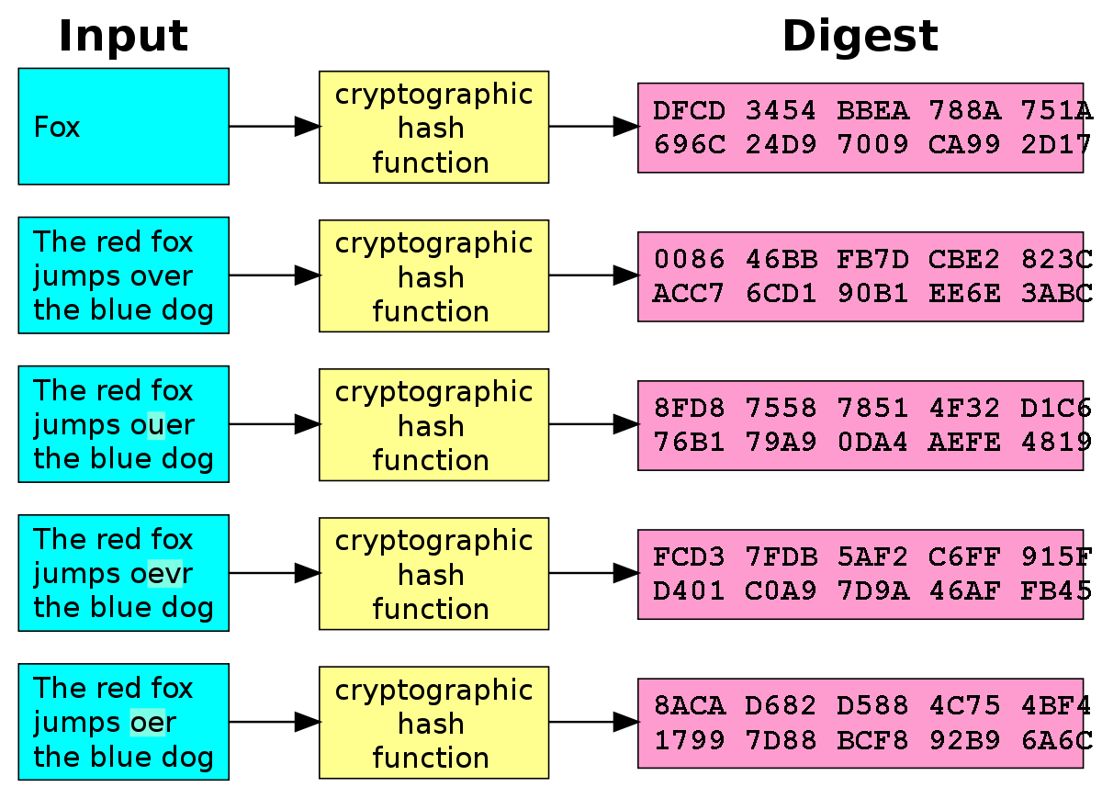
Hash Functions
Can use for encryption, authentication and digital signature.
Hash function accepts a variable-size message M as input and produces a fixed-size output, referred to as a hash code H(M).
A Hash Function produces a fingerprint of some file/message/data
h = H(M)
condenses a variable-length message M
to a fixed-sized fingerprint

Slide 55
Activity
Hash functions produce a fixed-size output
Certutil supports the following cryptographic hash functions: MD2, MD4, MD5, SHA1, SHA256, SHA384, SHA512.

Slide 56
Hash Functions
Hash code does not use a key
Function only of the input message (One-way function)
Also referred to as a message digest or hash value
The hash code is a function of all the bits of the message and provides an error-detection capability
A change to any bit or bits in the message results in a change to the hash code.

Slide 57
Activity
Hash is a one-way function – prove it!
Hash common password (google search common password list)
https://crackstation.net/
http://onlinemd5.com/
https://www.openwall.com/john/

Slide 58
Hash Function Properties
Assumed to be public
Provides integrity (error checking/checksum)
Provides authenticity (digital signature)
Provides security (to store sensitive data in d/b)

Slide 59
Activity
Hash functions provide integrity
Create a text file – save it and calculate the hash value.
Open the saved file, add space, save the file, calculate the hash value and compare.

Slide 60
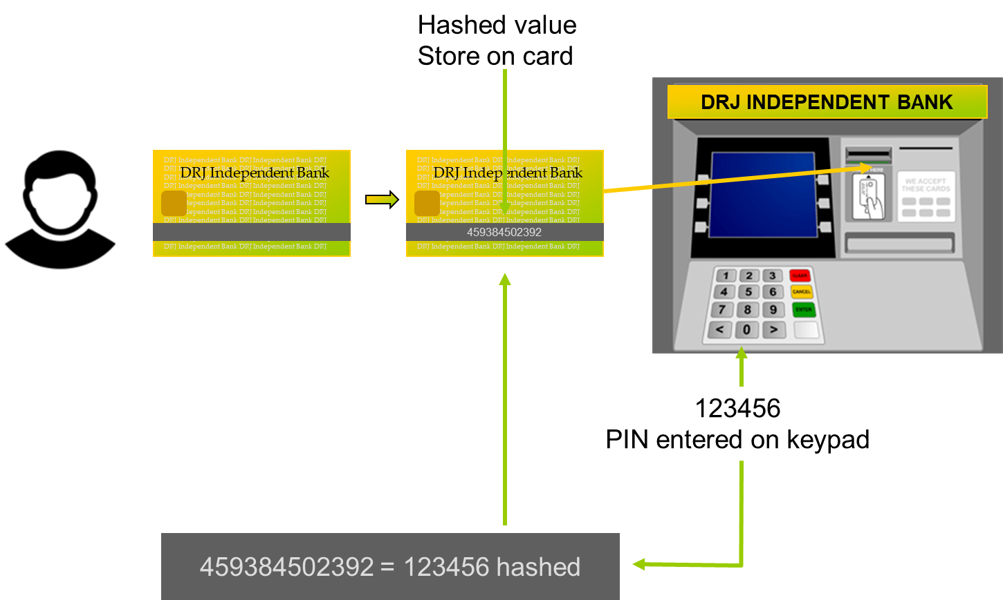
A Practical Use of Hash Algorithm

Slide 61
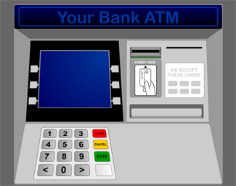
A Practical Use of Hash Algorithm
Hashed value
Store on card
DRJ INDEPENDENT BANK
DRJ Independent Bank
DRJ Independent Bank
DRJ Independent Bank DRJ Independent Bank DRJ Independent bank DRJ BANK
DRJ Independent Bank DRJ Independent Bank DRJ Independent bank DRJ BANK
DRJ Independent Bank DRJ Independent Bank DRJ Independent bank DRJ BANK
DRJ Independent Bank DRJ Independent Bank DRJ Independent bank DRJ BANK
DRJ Independent Bank DRJ Independent Bank DRJ Independent bank DRJ BANK
DRJ Independent Bank DRJ Independent Bank DRJ Independent bank DRJ BANK
DRJ Independent Bank DRJ Independent Bank DRJ Independent bank DRJ BANK
DRJ Independent Bank DRJ Independent Bank DRJ Independent bank DRJ BANK
DRJ Independent Bank DRJ Independent Bank DRJ Independent bank DRJ BANK
DRJ Independent Bank DRJ Independent Bank DRJ Independent bank DRJ BANK
DRJ Independent Bank DRJ Independent Bank DRJ Independent bank DRJ BANK
DRJ Independent Bank DRJ Independent Bank DRJ Independent bank DRJ BANK
DRJ Independent Bank DRJ Independent Bank DRJ Independent bank DRJ BANK
DRJ Independent Bank DRJ Independent Bank DRJ Independent bank DRJ BANK
DRJ Independent Bank DRJ Independent Bank DRJ Independent bank DRJ BANK
DRJ Independent Bank DRJ Independent Bank DRJ Independent bank DRJ BANK
DRJ Independent Bank DRJ Independent Bank DRJ Independent bank DRJ BANK
DRJ Independent Bank DRJ Independent Bank DRJ Independent bank DRJ BANK
DRJ Independent Bank DRJ Independent Bank DRJ Independent bank DRJ BANK
DRJ Independent Bank DRJ Independent Bank DRJ Independent bank DRJ BANK
DRJ Independent Bank DRJ Independent Bank DRJ Independent bank DRJ BANK
DRJ Independent Bank DRJ Independent Bank DRJ Independent bank DRJ BANK
DRJ Independent Bank DRJ Independent Bank DRJ Independent bank DRJ BANK
DRJ Independent Bank DRJ Independent Bank DRJ Independent bank DRJ BANK
DRJ Independent Bank DRJ Independent Bank DRJ Independent bank DRJ BANK
DRJ Independent Bank DRJ Independent Bank DRJ Independent bank DRJ BANK
DRJ Independent Bank DRJ Independent Bank DRJ Independent bank DRJ BANK
DRJ Independent Bank DRJ Independent Bank DRJ Independent bank DRJ BANK
DRJ Independent Bank DRJ Independent Bank DRJ Independent bank DRJ BANK
DRJ Independent Bank DRJ Independent Bank DRJ Independent bank DRJ BANK
DRJ Independent Bank DRJ Independent Bank DRJ Independent bank DRJ BANK
DRJ Independent Bank DRJ Independent Bank DRJ Independent bank DRJ BANK
DRJ Independent Bank DRJ Independent Bank DRJ Independent bank DRJ BANK
DRJ Independent Bank DRJ Independent Bank DRJ Independent bank DRJ BANK
DRJ Independent Bank DRJ Independent Bank DRJ Independent bank DRJ BANK
DRJ Independent Bank DRJ Independent Bank DRJ Independent bank DRJ BANK
DRJ Independent Bank DRJ Independent Bank DRJ Independent bank DRJ BANK
DRJ Independent Bank DRJ Independent Bank DRJ Independent bank DRJ BANK
459384502392
459384502392
459384502392 = 123456 hashed
123456
PIN entered on keypad
Use Hashing Algorithm
The hash value is based on algorithm
Haval MD2 MD4 MD5
SHA Hash Functions (SHA-1, SHA-2)

Slide 62
List of Cryptographic Hash Function
Haval
RIPEMD-160
MD2
SHA Hash Functions
(SHA-0, SHA-1, SHA-2)
MD4
Snefru
MD5
Tiger
N-Hash
Whirlpool

Slide 63
Steganography

Slide 64


Steganography
Steganography is the technique of hiding secret data within an ordinary, non-secret, file or message in order to avoid detection; the secret data is then extracted at its destination.
The use of steganography can be combined with encryption as an extra step for hiding or protecting the data.

Slide 65
Quick Review Question
Explain how cryptography is used as security mechanisms.

Slide 66
Summary of Main Teaching Points
Cryptographic Techniques
Symmetric
Asymmetric
Hash function

Slide 67

Q & A

